Slide 1





e-Commerce Mobile Application On

Slide 2

Who and What is being Presented?
Introduction : Ntsane Kolisang
Project Management Status Report : Ntsane Kolisang
Risk Management
Challenges and Solutions
Iteration 3 : Analysis : Giovanna Contu, Tsungai Makoni
Iteration 3 : Design : Abram Rankapole
Iteration 3 : Development : Ronald Chinku, Dusan Gnjatic
Next Iteration Plans : Ntsane Kolisang

Slide 3




Introduction
The Project Team :
Our Customer :
Our End User :
The Facilitator :

Slide 4
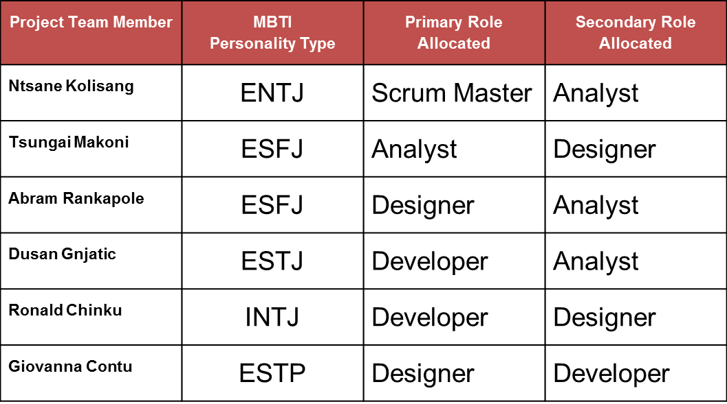
Introducing the Team

Slide 5
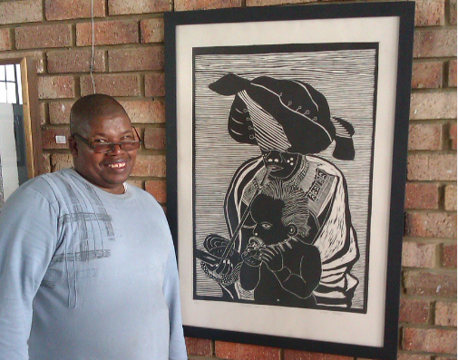
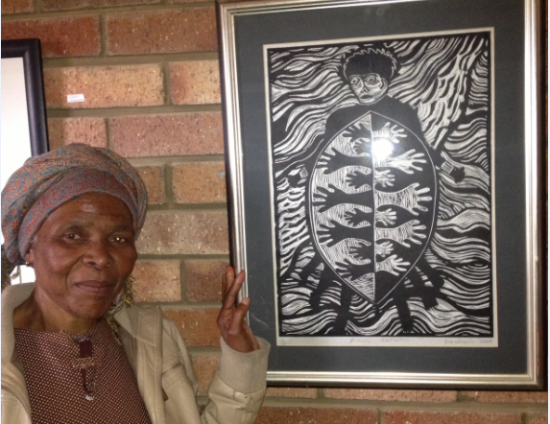
Introducing the End User
Mr. Vukile Teyise
Mrs. Noluthando Tana

Slide 6
Introduction - Project Objective
To project manage, develop, install, test and commission an android platform mobile application for Reed house Systems to be used by Egazini Outreach Project.

Slide 7
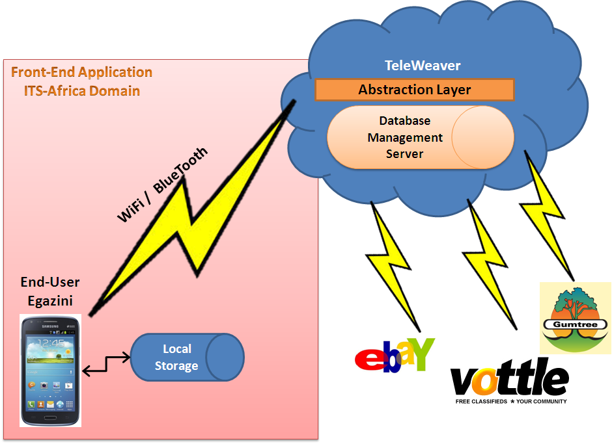
Introduction
Network Architecture Diagram - Our Operation

Slide 8
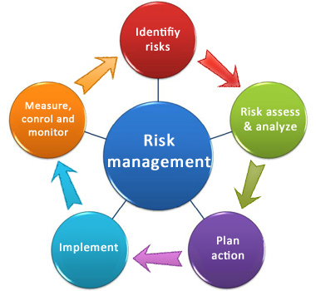
Project Management Status Report Iteration - 3
No. | Potential Risk | Category | Root Cause | Triggers | Potential Responses | Risk Owner
1 | Misunderstanding of the requirements | Requirements Risk | Poor Interpretation of the End User and Customer requirements. Poorly defined customer requirements. | End-user and Customer commentary during project meetings, JAD sessions or during testing | Have a JAD Session with the end-user and the customer. | Analyst
2 | Conflict between the end-user and the customer | Key Stakeholder | Nonaligned project objectives. | User not satisfied with the end product | Enable a Jad Session to align objectives | Project Manager
3 | Communication breakdown | Communication | Not providing feedback or communicating things on time. | Lack of communication devices or medium | Ensure that there is a wide range of communication devices that are being used throughout the project | Project Manager
4 | Conflict between the team members | Organisational Risk | Personalities not getting along. | Poor work ethic. Stress. | Hold and internal meeting and discuss issues with the purpose of ensuring compliance to the team agreement | Project Manager
5 | Technology Complexities | Technical Risk | Lack of knowledge | In ability for make features of the program to work | Get assistance from ICT expertise available from the department and the customer’s side. | Programmer
6 | A non-user centred design | Technical Risk | Not involving the user during the development of the system | Commentary during testing | Ensure that end-users are involved extensively in the project. | Designer

Slide 9
Project Management Status Report Iteration – 3 : Risk Impact
Risk Item | Probability | Impact | Status
1 | Low | High | Under Control
2 | Low | Low | Under Control
3 | High | High | Under Control
4 | Low | Medium | Under Control
5 | High | High | Under Control
6 | Low | High | Under Control

Slide 10
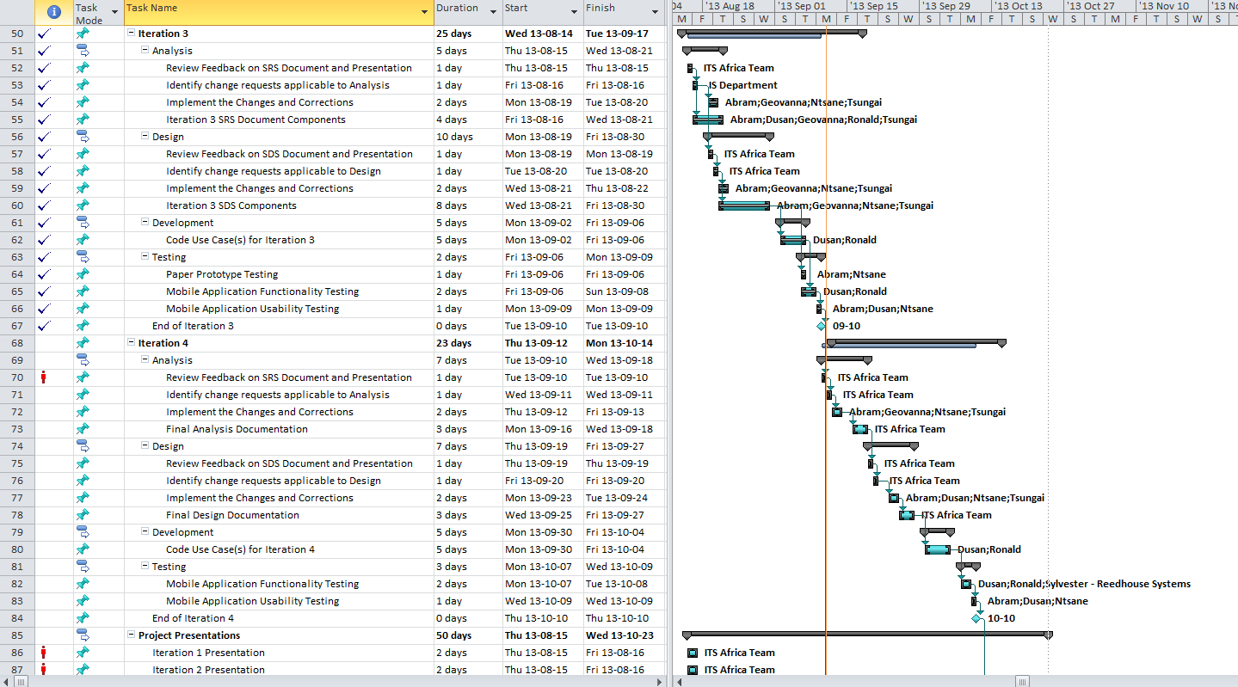
Project Management Status Report Iteration – 3 Gantt Chart

Slide 11
Project Management Status Report Iteration – 3 : Work Progress to date
Updating of project management documentation.
Implemented Changes and Corrections on the SRS and SDS.
Effecting Change Requests For :
Analysis – Context Diagram , Use cases and associated diagrams for the Administrator for purpose of academic interest.
Design – Use cases, Class Diagrams, Sequence diagrams , use case narratives and package diagrams
Key Technical Meeting with Reed House Systems on posting to Teleweaver and redesign of the Iconography.
Usability Testing
Implemented Iteration 3 Use Cases.

Slide 12
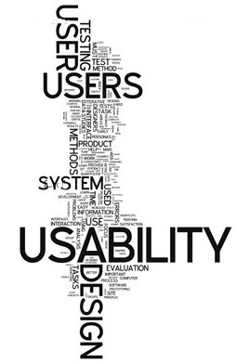
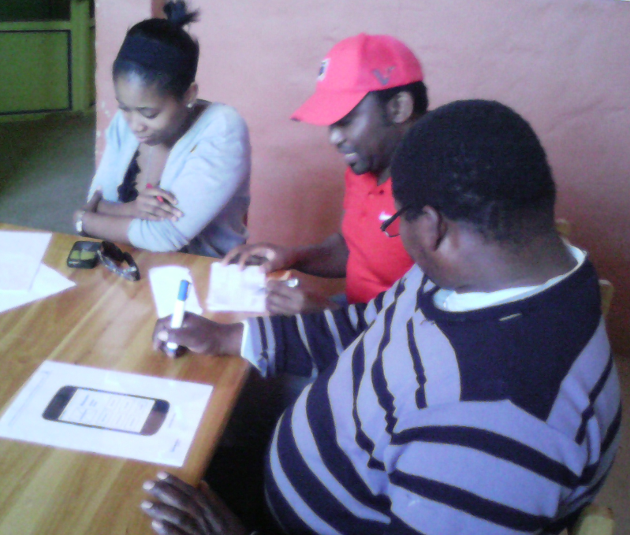
Project Management Status Report Iteration – 3 : Usability Testing
Paper Prototype Testing

Slide 13
Project Management Status Report Iteration – 3 : Challenges & Solutions
Project Management Deliverables Clarified through a meeting
Actual End User Usability Testing Revealed :
Some of the end users are unfamiliarity with devices which means we have to invest in hardware training as well.
Language Incompatibility which led to ICON , color and hardcoded Xhosa usage to Aid users.
Lack of language localisation package which has been rectified by hardcoding Xhosa.
Teleweaver has not been Interrogated as yet as we received the confirmation for Database SQL settings yesterday. We envision full operation before the end of the 27th of September 2013

Slide 14

Iteration 3 : Context Diagram
Artist
Artist
Product pictures
Picture details
Artist details
Gallery (product pictures)
Sales report
Inventory report
Profile preview
Egazini e-commerce Mobile Application
Product pictures
Product details
Picture details
Sale details
Artist details
Payment notification
Sales Details
TeleWeaver
TeleWeaver

Slide 15
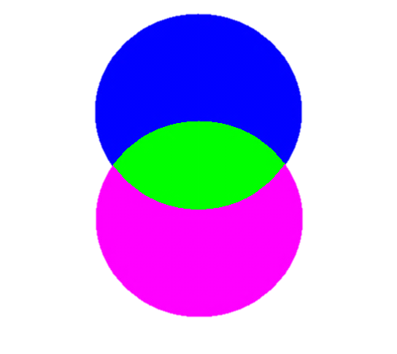
Artist
Gallery (product pictures)
Sales report
Inventory report
Profile preview
Artist
Artist
Egazini E-Commerce Mobile Application
Product pictures
Picture details
Artist details
(offline)
(offline)
TeleWeaver
(online)
TeleWeaver
Payment notification
Sales details
(online)
Access Control
Synchronisation (product pictures, artist details, picture details)
TeleWeaver
Restful Web Services
TeleWeaver
Access request
Artist
Artist
Technical access information
Login details
Sale notification (email/SMS)
Payment
TeleWeaver System
Artist
Artist
Registration details
Vendor
Product pictures
Product details
Sale details
Vendor
Buyer
Payment details
Sales details
Buyer
Sales confirmation
Products
Buyer
Buyer

Slide 16
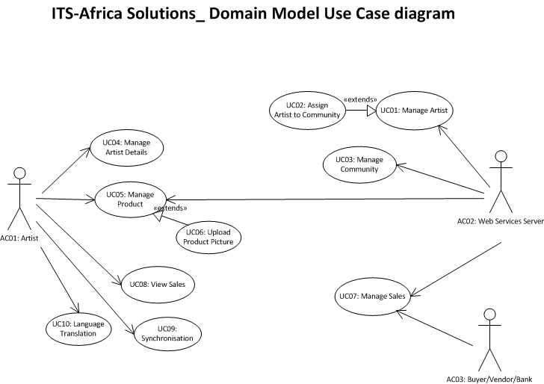
Iteration 3: Use Case Diagram
Iteration 1
Iteration 3
Iteration 2
Iteration 3
Iteration 3
ITS-Africa Solutions
Reed House Systems

Slide 17
Iteration 3: Class Diagram

Slide 18
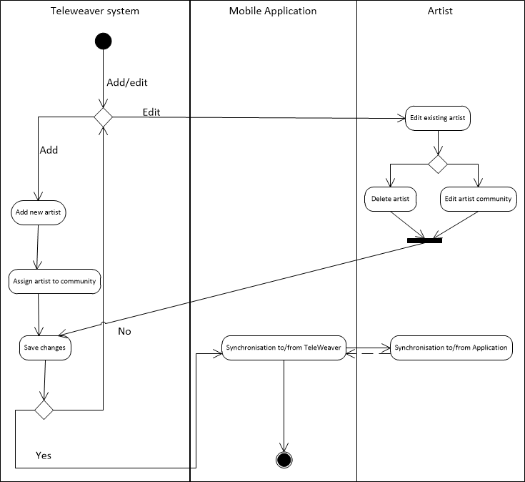
Activity Diagram: Upload a Product picture

Slide 19
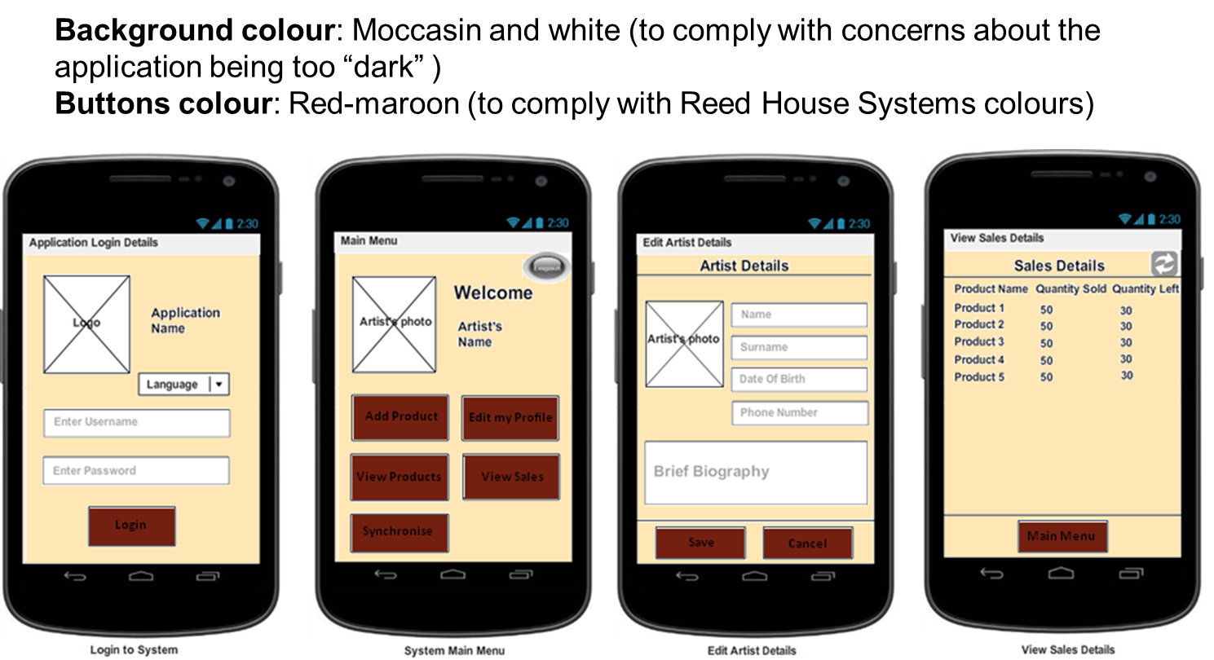
Iteration 3 : Design Interface Changes

Slide 20
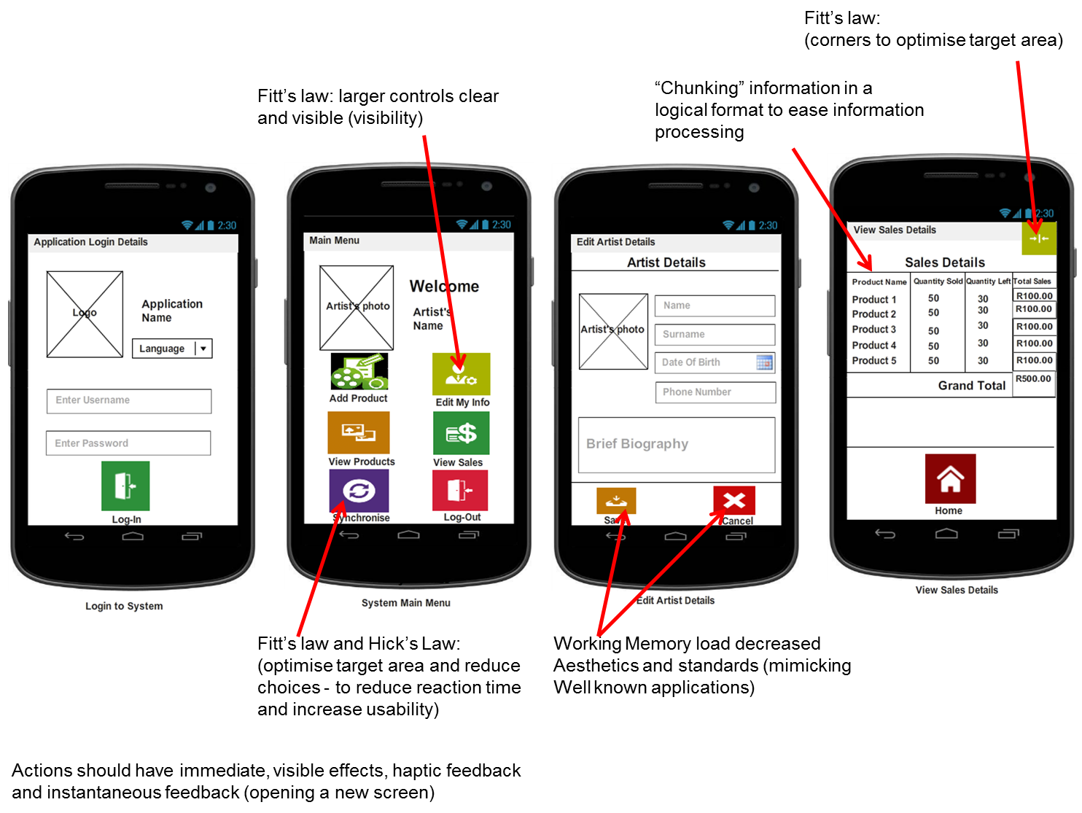

Slide 21
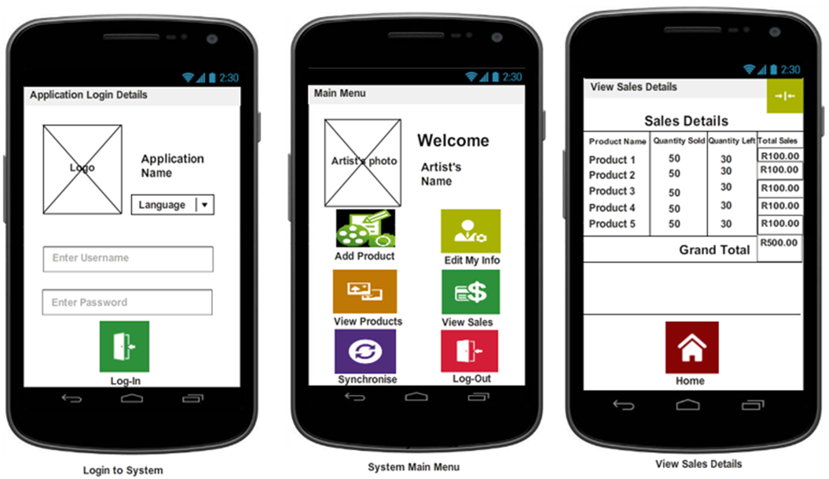
Iteration 3 : Design Storyboard for View Sales Details

Slide 22


Iteration 3 : Implementation
Platform - Basic4Android
Iteration 3 Use Cases:
View Sales Details,
Synchronization
Language Translation

Slide 23
Next Iteration Plans
Final Project documentation
Correct the SRS and Present Final SRS
Correct the SDS and Present Final SDS
Review and Implement Change Requests
Iteration 4
Synchronisation to Teleweaver
Upload Products to Teleweaver
View Sales ( After Retrieving Report From Teleweaver)

Slide 24
Q&A
Questions and Answers

